Slide 1
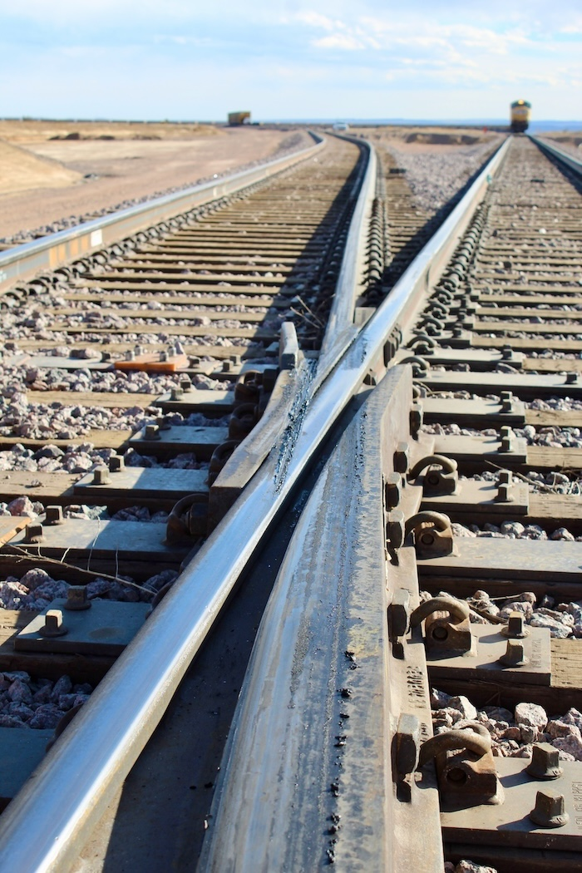
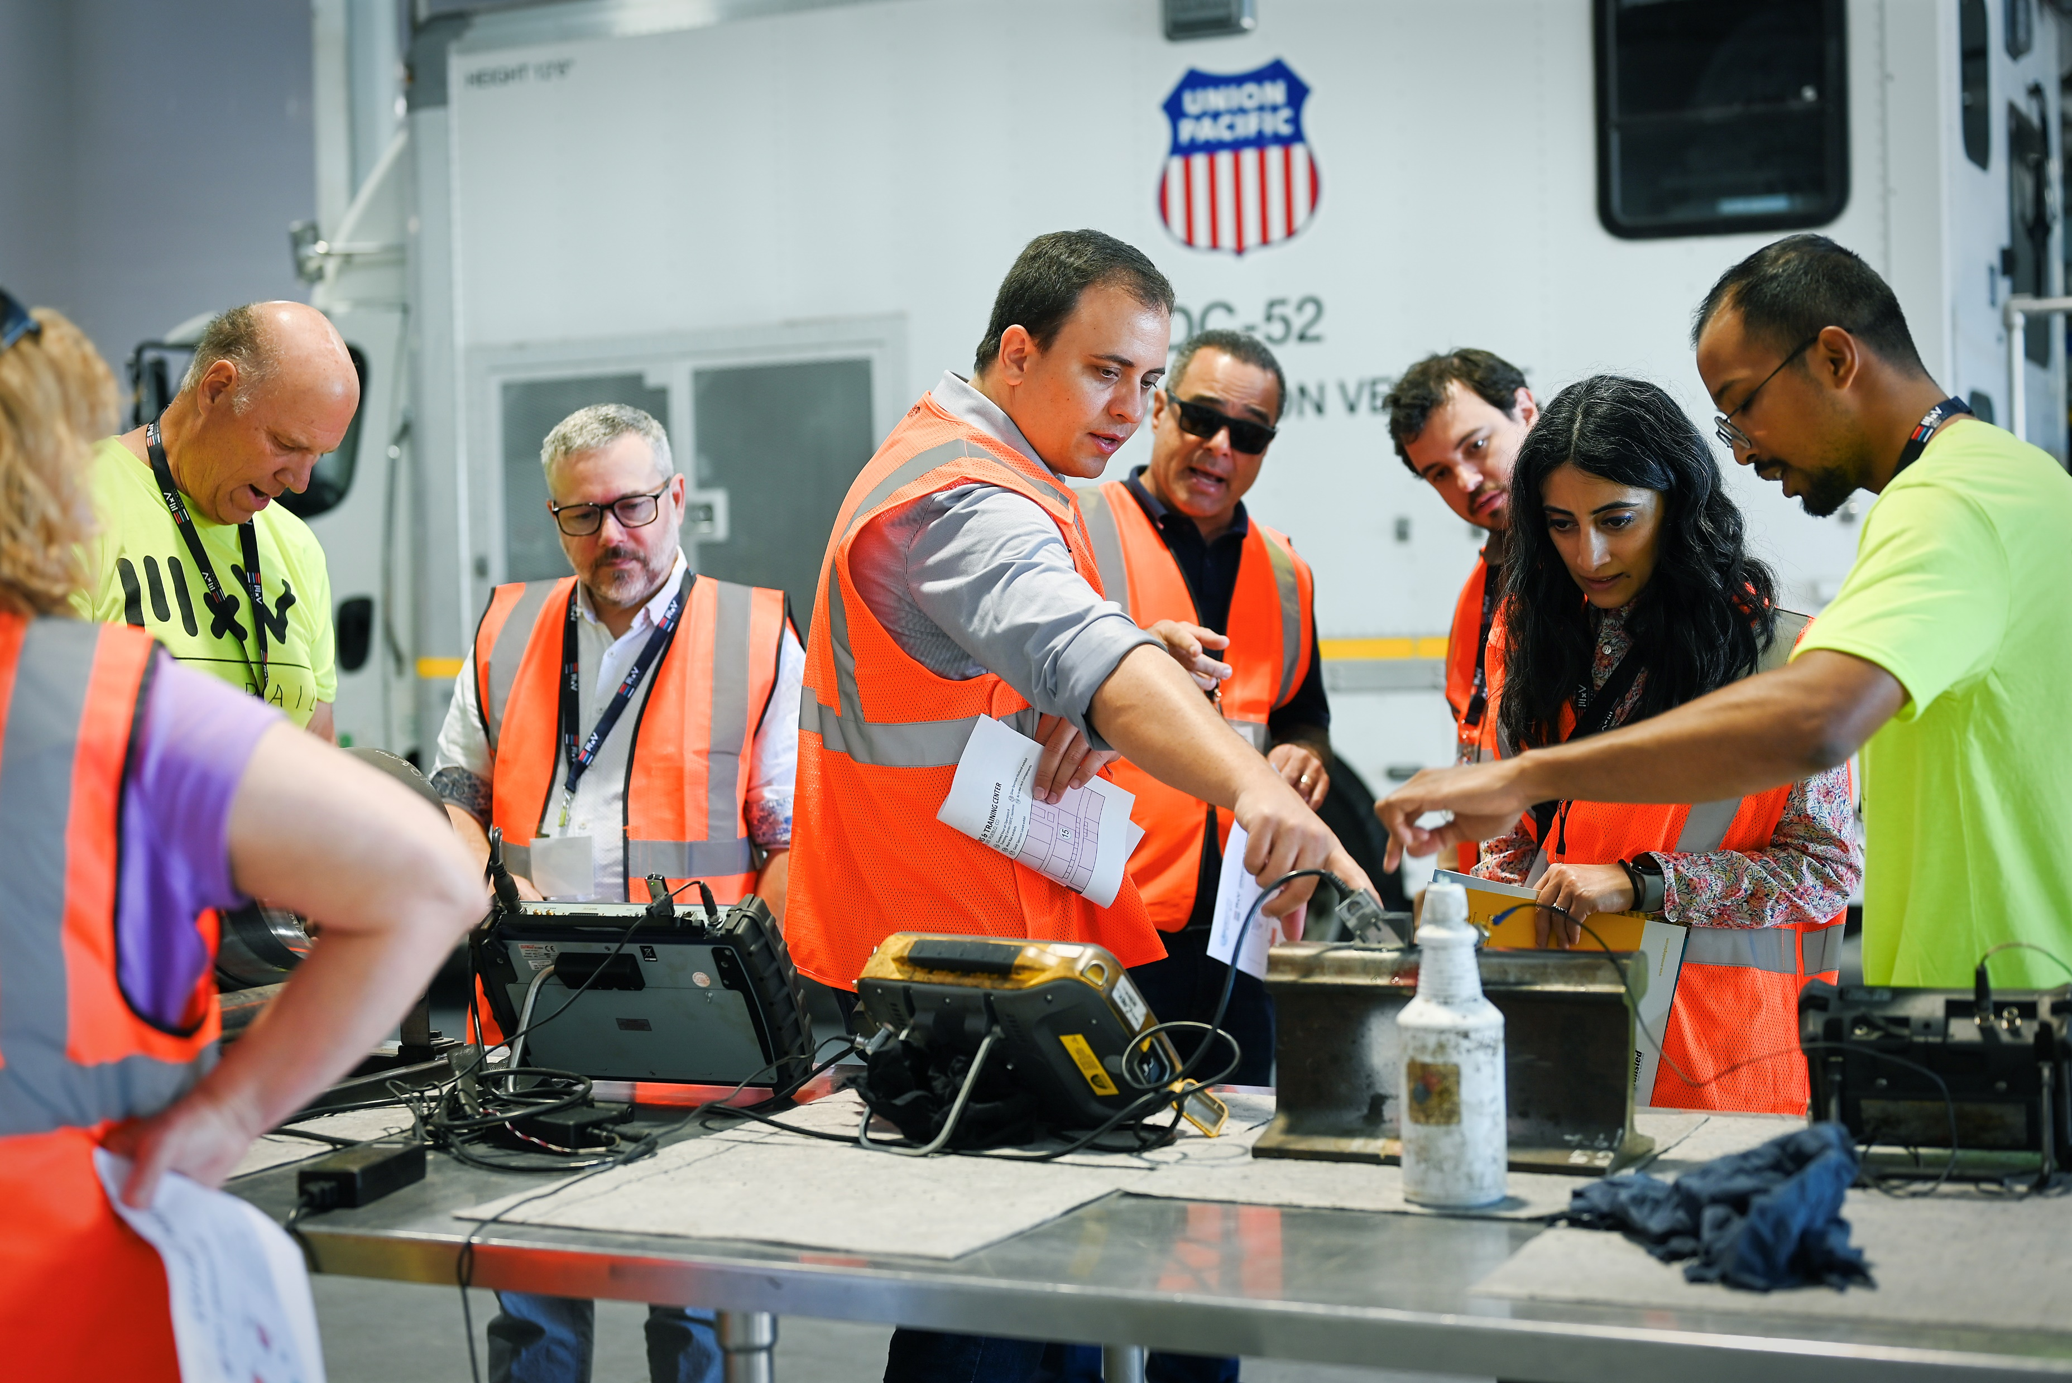
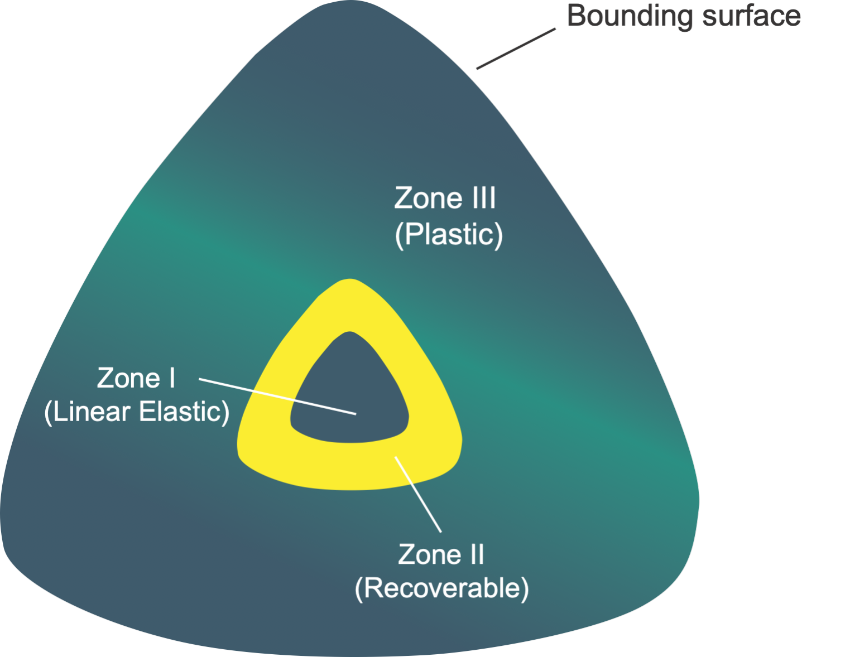
This is the title of the poster and it can be 1 or 2 lines [Arial , bold, 80pt , white, small caps]
A.B. Author & C. Author [Arial, bold, 32pt, black]
Affiliation1, City1, Country1 [Arial, italics, 32pt, black]
D.E. Author
Affiliation2, City2, Country2
To insert a picture of the main author, or the sample images below:
Right-click on the ‘C’ with yellow circle
_{Choose “Change picture”}
_{“Insert Picture” from file}
Choose the correct picture from your computer
Introduction [Arial, bold, 44pt, black]
This template provides two possible layouts with text and graphs separate and another layout on the second page. The third page contains an evaluation sheet with useful recommendations for creating an effective poster – please evaluate your poster before submission. [Normal text, Arial, 30pt]
In the Introduction part, get your viewer interested in the issue or question while using the absolute minimum of background information and definitions; quickly place your issue in the context of published, primary literature; then pitch an interesting, novel hypothesis … then you can describe (briefly) the experimental approach that tested your hypothesis. Unlike a manuscript, the introduction of a poster is a wonderful place to put a photograph or illustration that communicates some aspect of your research question.
[100 - 200 words]
Experimental work
Briefly describe experimental equipment and procedure, but not with the detail used for a manuscript; use figures and flow charts to illustrate experimental design if possible; include photograph or labelled drawing of organism or setup; mention statistical analyses that were used and how they allowed you to address hypothesis.
[100 - 200 words]
Results
First, mention whether your experiment procedure actually; in same paragraph, briefly describe qualitative and descriptive results to give a more personal tone to your poster; in second paragraph, begin presentation of data analysis that more specifically addresses your hypothesis; refer to supporting charts or images; provide extremely engaging figure legends that could stand on their own (i.e., could convey some point to reader if viewer skipped all other sections, which they will do); place tables with legends, too, but opt for figures whenever possible. This is always the largest section (except if you have no data).
[approximately 200 words, not counting figure legends]
Conclusions
Remind the reader (without sounding like you are reminding the reader) of the major result and quickly state whether your hypothesis was supported; try to convince the visitor why the outcome is interesting; state the relevance of your findings to other published work; relevance to real organisms in the real world; future directions.
[100 - 200 words]
References
List references cited in the text according to the Harvard method, alphabetically e.g.:
Last name, Initials. Year. Book title. City: Publisher.
Last name, Initials. Year. Title of article. Title of Journal (series number) volume number (issue number): page numbers.
[max. 5 citations]
Acknowledgments
Thank individuals for specific contributions (equipment donation, statistical advice, laboratory assistance, comments on earlier versions of the poster); mention who has provided funding; be sincere but do not lapse too much into informality in this section; do not list people’s titles (e.g., write Colin Purrington not Dr Purrington). Also include in this section disclosures for any conflicts of interest and conflicts of commitment.
[approximately 40 words]
SAMPLE PICTURE
You are welcome to use any layout for your text and figures, as long as you stay within the white allocated space
Figure 1. [Caption title]
Figure 2. [Caption title]
SAMPLE PICTURE
Figure 3: [Caption title]
SAMPLE FIGURE
For readability, make sure that normal text and graph text is not smaller than 24pt!
Figure 4: [Caption title]
For further information please contact:
[Name] , [Organisation], [Email address]
[Name] , [Organisation], [Email address]
Change this to your own organization’s logo -
Right-click on the ‘MxV Rail logo’
_{Choose “Change picture”}
_{“Insert Picture” from file}
Choose the correct picture from your computer

Slide 2
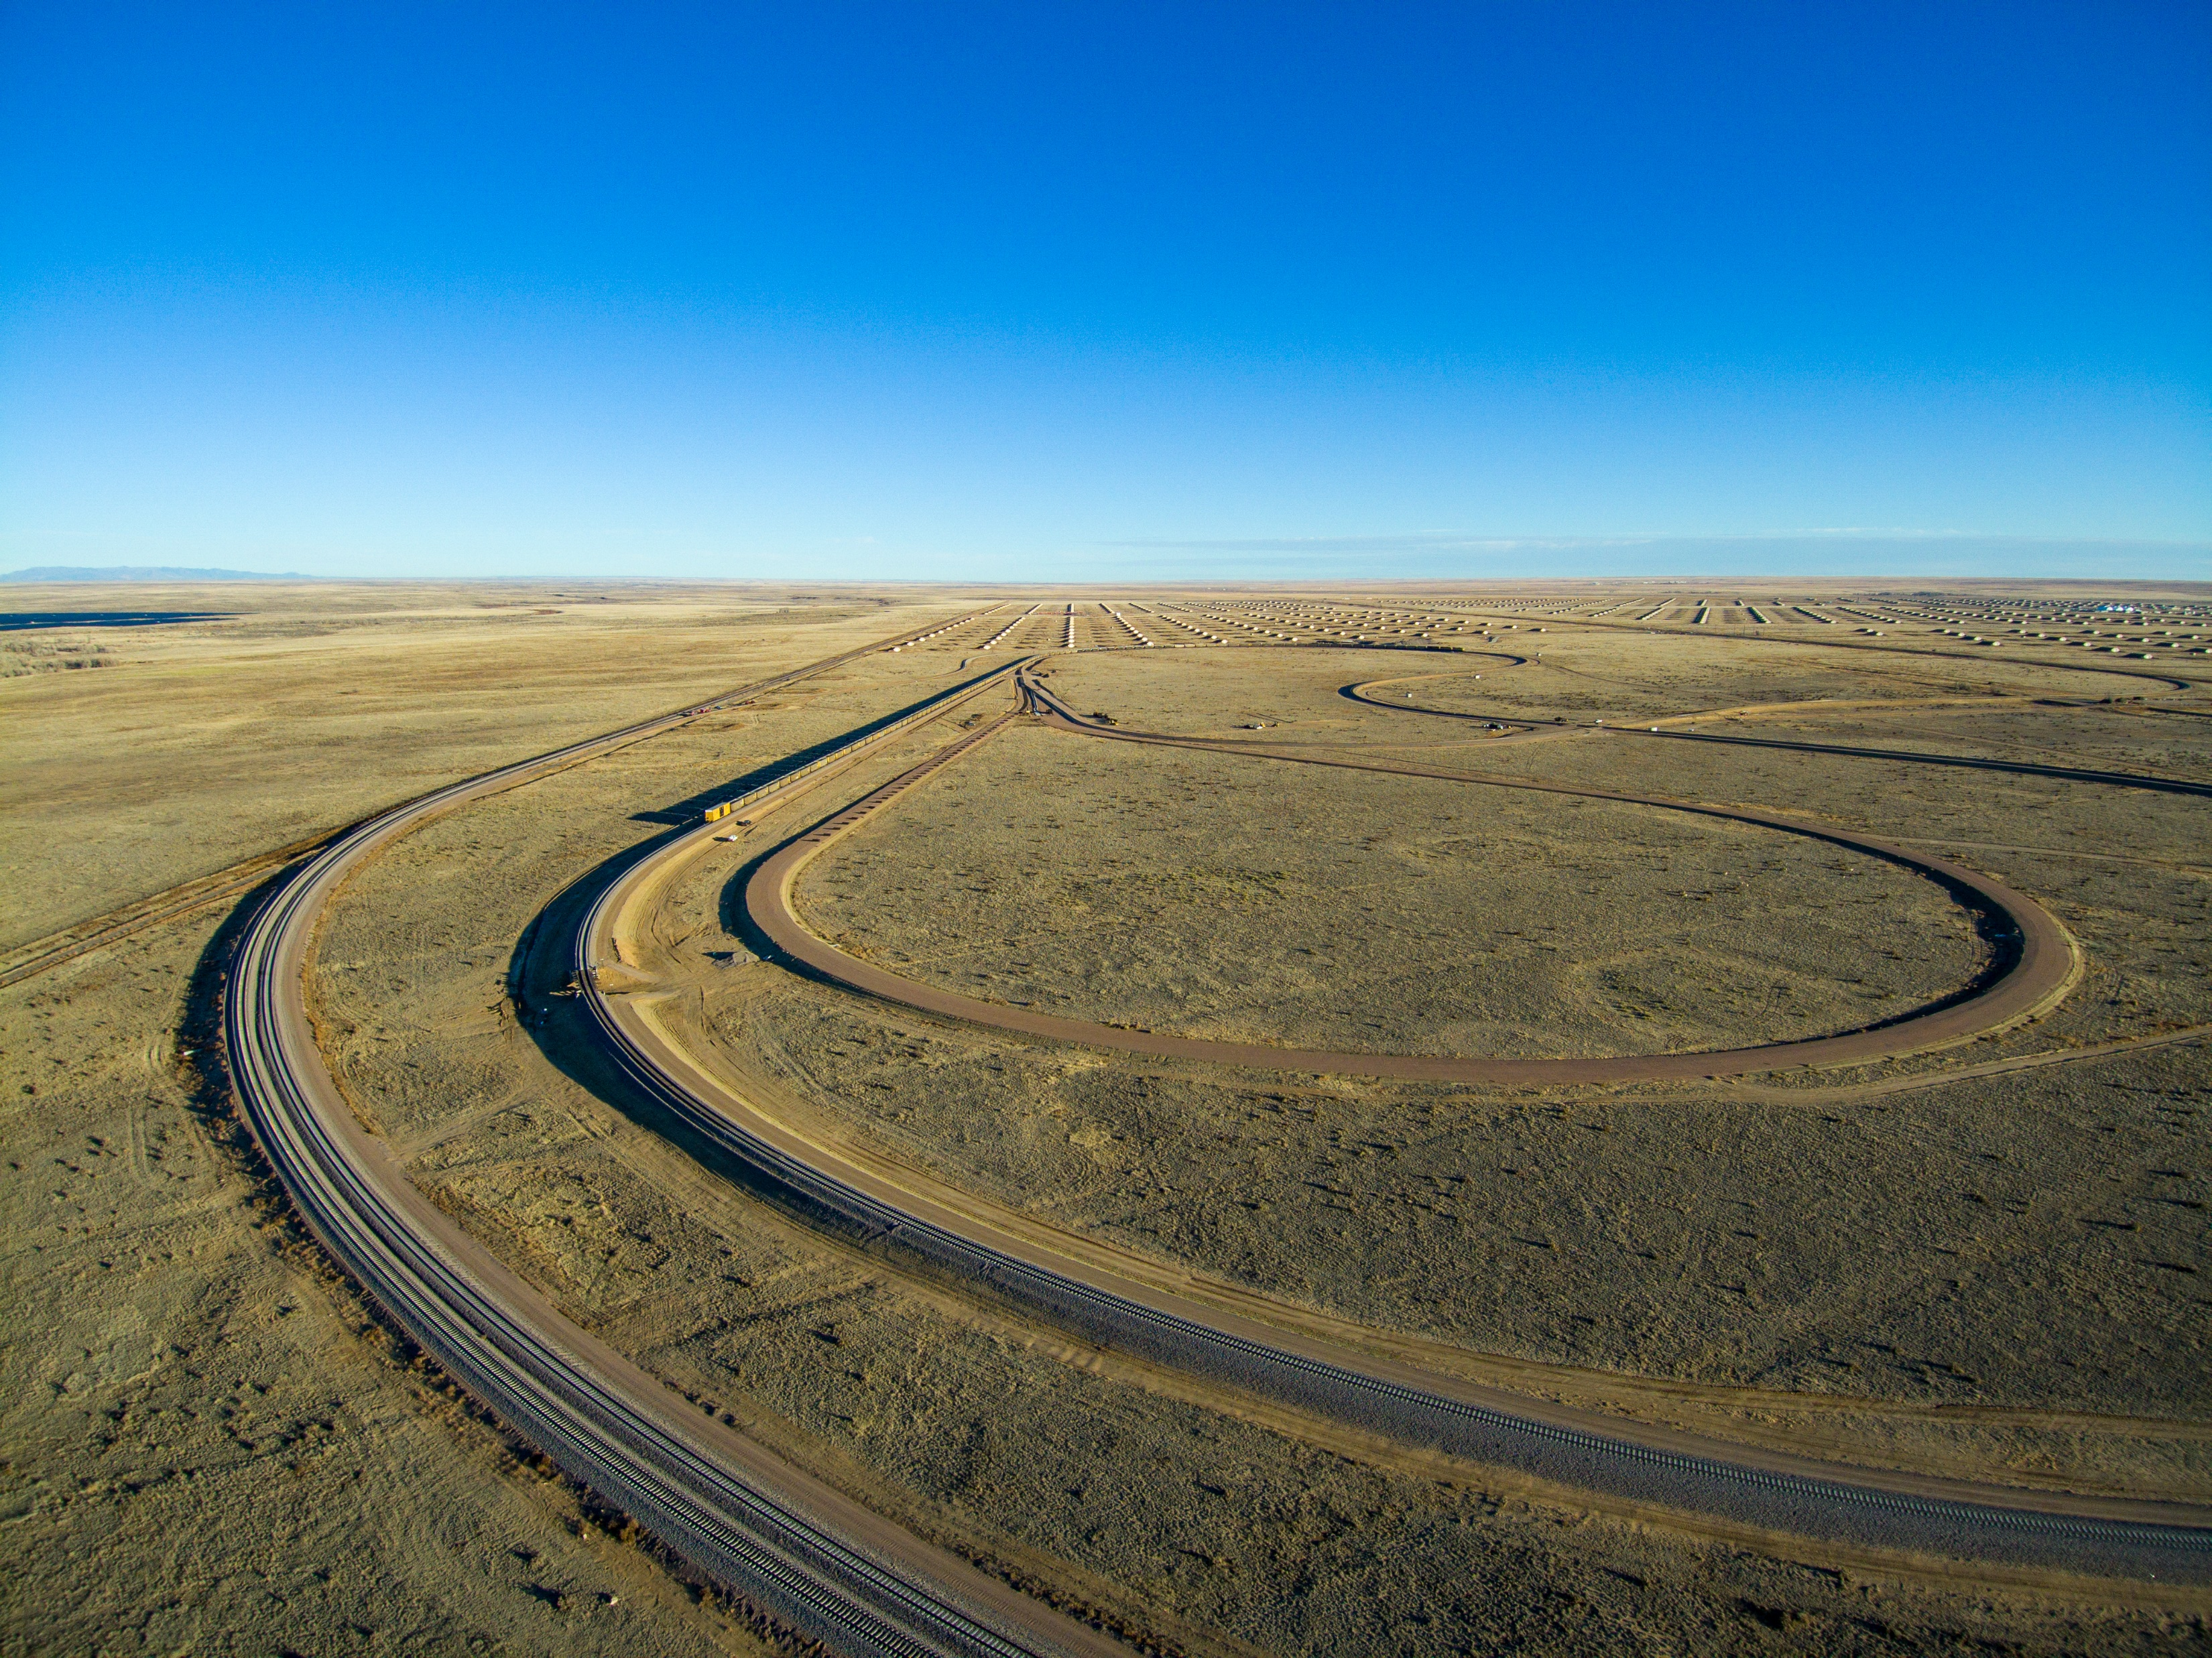
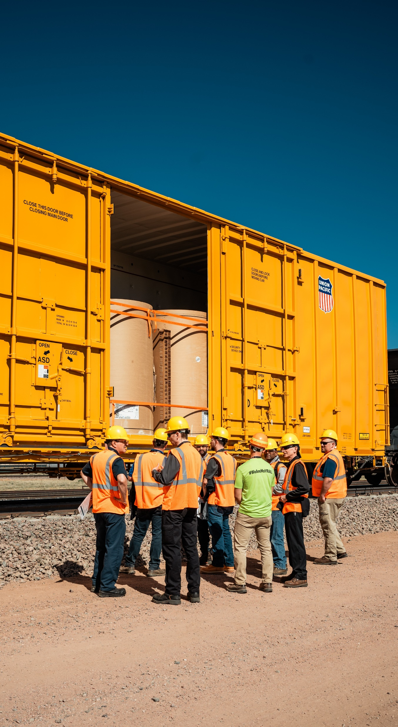
This is the title of the poster and it can be 1 or 2 lines [Arial , bold, 80pt , white, small caps]
A.B. Author & C. Author [Arial, bold, 32pt, black]
Affiliation1, City1, Country1 [Arial, italics, 32pt, black]
D.E. Author
Affiliation2, City2, Country2
To insert a picture of the main author, or the sample images below:
Right-click on the ‘C’ with yellow circle
_{Choose “Change picture”}
_{“Insert Picture” from file}
Choose the correct picture from your computer
Introduction [Arial, bold, small caps, 44pt, black]
This template provides two possible layouts with text and graphs separate and another layout on the second page. The third page contains an evaluation sheet with useful recommendations for creating an effective poster. Please evaluate your poster before submission. [Normal text, Arial, 30pt]
In the Introduction part, get your viewer interested in the issue or question while using the absolute minimum of background information and definitions; quickly place your issue in the context of published, primary literature; then pitch an interesting, novel hypothesis … then you can describe (briefly) the experimental approach that tested your hypothesis. Unlike a manuscript, the introduction of a poster is a wonderful place to put a photograph or illustration that communicates some aspect of your research question.
[100 - 200 words]
Experimental work
Briefly describe experimental equipment and procedure, but not with the detail used for a manuscript; use figures and flow charts to illustrate experimental design if possible; include photograph or labeled drawing of organism or setup; mention statistical analyses that were used and how they allowed you to address hypothesis.
[100 - 200 words]
Conclusions
Remind the reader (without sounding like you are reminding the reader) of the major result and quickly state whether your hypothesis was supported; try to convince the visitor why the outcome is interesting; state the relevance of your findings to other published work; relevance to real organisms in the real world; future directions.
[100 - 200 words]
You are welcome to use any layout for your text and figures, as long as you stay within the white allocated space
SAMPLE PICTURE
Figure 3: [Caption title]
References
List references cited in the text according to the Harvard method, alphabetically:
Last name, Initials. Year. Book title. City: Publisher.
Last name, Initials. Year. Title of article. Title of Journal (series number) volume number (issue number): page numbers.
[max. 5 citations]
Acknowledgments
Thank individuals for specific contributions (equipment donation, statistical advice, laboratory assistance, comments on earlier versions of the poster); mention who has provided funding; be sincere but do not lapse too much into informality in this section; do not list people’s titles (e.g., write Colin Purrington not Dr Purrington). Also include in this section disclosures for any conflicts of interest and conflicts of commitment.
[approximately 40 words]
SAMPLE PICTURE
Figure 1. [Caption title]
Figure 2. [Caption title]
Results
First, mention whether your experiment procedure actually; in same paragraph, briefly describe qualitative and descriptive results to give a more personal tone to your poster; in second paragraph, begin presentation of data analysis that more specifically addresses your hypothesis; refer to supporting charts or images; provide extremely engaging figure legends that could stand on their own (i.e., could convey some point to reader if viewer skipped all other sections, which they will do); place tables with legends, too, but opt for figures whenever possible. This is always the largest section (except if you have no data).
[approximately 200 words, not counting figure legends]
For readability, make sure that normal text and graph text is not smaller than 24pt!
SAMPLE FIGURE
Figure 4: [Caption title]
For further information please contact:
[Name] , [Organisation], [Email address]
[Name] , [Organisation], [Email address]
Change this to your own organization’s logo -
Right-click on the ‘MxV Rail logo’
_{Choose “Change picture”}
_{“Insert Picture” from file}
Choose the correct picture from your computer

Slide 3
EVALUATE YOUR POSTER IN 60 SECONDS
EVALUATE YOUR POSTER IN 60 SECONDS
This table provides a useful evaluation to judge the quality of your poster. Rate your poster with reference to the main aspects on the left and by using the 0 – 2 allocation of scores provided here. Do not submit if your score is below 10!
Overall Appearance | 0 | Cluttered or sloppy appearance. Gives the impression of a solid mass of text and graphics, or pieces are scattered and disconnected. Little white space.
 | 1 | Pleasant to look at. Pleasing use of colors, text, and graphics
 | 2 | Very pleasing to look at. Particularly nice colors and graphics.
White Space | 0 | Very little. Gives the impression of a solid mass of text and graphics.
 | 1 | OK. Sections of the poster are separated from one another.
 | 2 | Lots. Plenty of room to rest the eyes. Lots of separation
Text / Graphics Balance | 0 | Too much text. The poster gives an overwhelming impression of text only. OR Not enough text. Cannot understand what the graphics are supposed to relate.
 | 1 | Balanced. Text and graphics are evenly dispersed in the poster; enough text to explain the graphics.
Text Size | 0 | Too small to view comfortably from a distance of 1-1.5 meters.
 | 0.5 | Main text OK, but text in figures too small.
 | 1 | Easy to read from 1-1.5 meters.
 | 2 | Very easy to read.
Organization and Flow | 0 | Cannot figure out how to move through poster.
 | 1 | Implicit. Headings (Introduction, Methods, etc.) or other device implies organization and flow.
 | 2 | Explicit numbering, column bars, row bars, etc.
Author Identification | 0 | None.
 | 1 | Partial. Not enough information to contact author without further research. This includes missing zip codes on addresses.
 | 2 | Complete. Enough information to contact author by mail, phone, or e-mail without further research.
Research Objective | 0 | Can't find.
 | 1 | Present, but not explicit. Buried at end of "Introduction", Background", etc.
 | 2 | Explicit. This includes headings of "Objectives", "Aims", "Goals", etc.
Main Points | 0 | Can't find.
 | 1 | Present, but not obvious. May be imbedded in monolithic blocks of text.
 | 2 | Explicitly labelled (e.g., "Main Points", "Conclusions", "Results").
Summary | 0 | Absent.
 | 1 | "Summary", "Results", or "Conclusions" section present.
TOTAL SCORE: | 15
Copyright ©1999 George Hess - NC State University - Forestry Department

